Slide 1

BIKE RENTAL ANALYSIS
This presentation offers a comprehensive overview of bike rental patterns, examining the trends and behaviors associated with these rentals.
It will provide an analysis of several key factors that influence rental outcomes, including temporal dynamics, weather conditions, and other contextual variables.

Slide 2
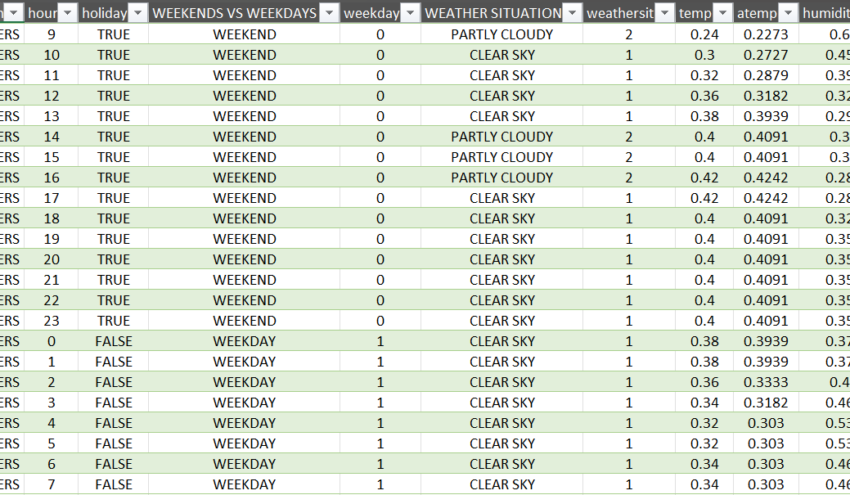
Datasets and objectives
Temporal Patterns- indexed by specific details like hour, day, date, weekends/weekdays, season, and holiday help analyze rental trends and usage patterns over different timescales and their effect on bike rentals.
Weather Impact- includes comprehensive data of weather situations, humidity, temperature, assumed temperature (atemp), windspeed, that helps evaluate different variables and their influence, facilitating insights on weather- related fluctuations
User Segment- supports analysis of usage patterns of casual and registered users and their preferences, revealing distinct patterns and behavioral trends.

Slide 3
Data analysis and visualization
Data Analysis
1. Clean and organize the raw data by removing duplicates, applying filters, filling missing values, formatting, and using functions to eliminate inconsistencies.
2. Merge dataset 1 and dataset 2 to create dataset A, then Append dataset A and dataset 3 to generate the final dataset using Power Query, and repeat the process of cleaning on dataset A and the final dataset.
3. Apply correlation [=corre()] and standard deviation [=std.s()] techniques to explore and identify patterns within the data.
Data Visualization
Comprehensive visualization, like Line Graph, Pie Chart, Scatter Plot, etc., created using Pivot Charts, is used to represent the data insights. To have in-depth insight, Slicers and Timelines are added.
Create an interactive Dashboard using these pivot tables and charts
These charting techniques are used to highlight underlying patterns and relationships between the variables of the data.

Slide 4
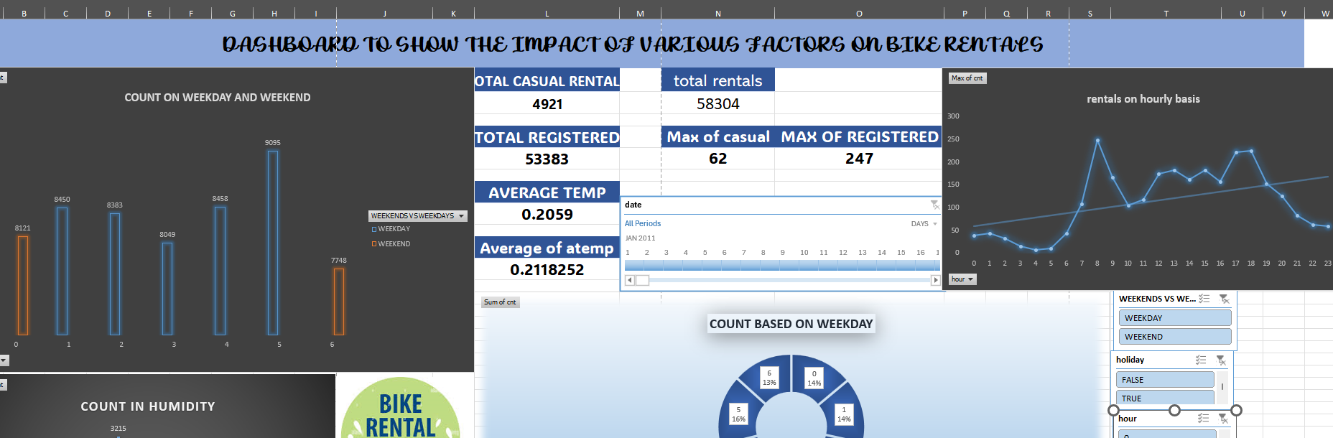
DASHBOARD

Slide 5
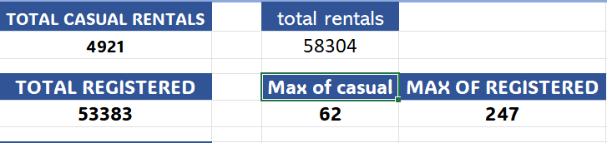
TOTAL RENTALS AND USER SEGMENTS…
Total Rentals- represents the overall count of rentals recorded, indicating demand and usage across the period.
Casual Rentals- they are significantly fewer, showing that occasional users make up a smaller portion of total activity. Here, a maximum of 62 rentals were recorded in a single hour.
Registered Rentals- It highlights a strong base of customers. It suggests that registered users contribute the most, and targeting them might optimize business strategies.

Slide 6
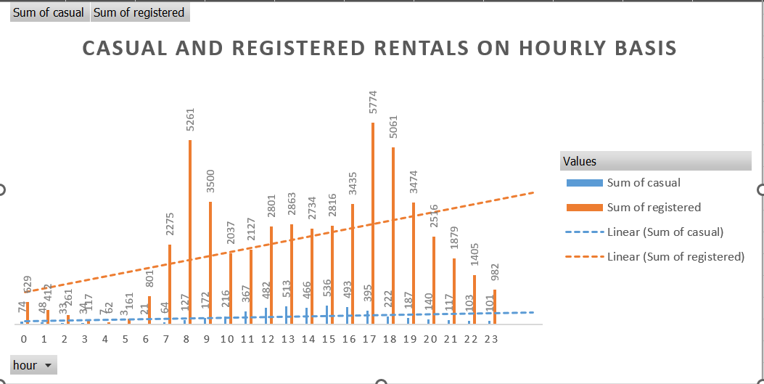
HOURLY RENTAL TRENDS AND PEAK TIMES
This chart illustrates the pattern of total bike rentals throughout the day, segmented by user type into registered and casual users. It provides insights into peak rental hours and differences in user behavior across the day, helping to understand demand fluctuations over time.

Slide 7
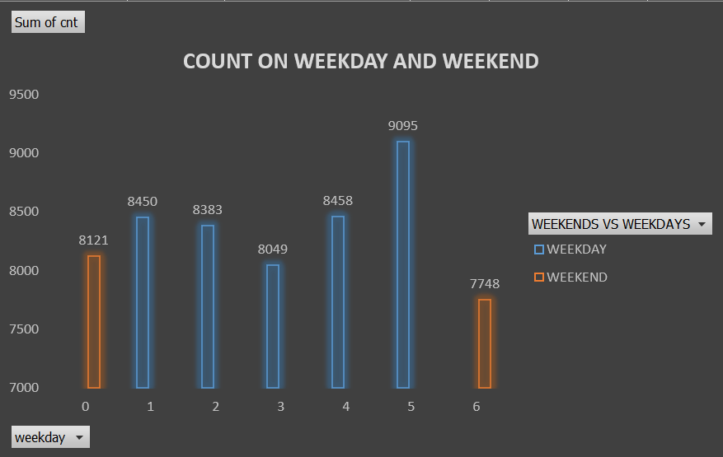
Weekend vs weekday patterns
WEEKEND RENTAL SUMMARY
The total number of bicycle rentals during the weekend reached 15,869, indicating a lower overall usage compared to weekdays. Nonetheless, there is a significant increase in activity during midday hours, which suggests a rise in leisure and recreational trips during this time.
WEEKDAY RENTAL SUMMARY
The analysis of bike rentals reveals that the total number of rentals per weekday varies, with 8,121 rentals occurring on Monday and 7,748 on Sunday. This data indicates a consistent trend of higher bike usage during weekdays, which reflects patterns associated with daily commuting.

Slide 8
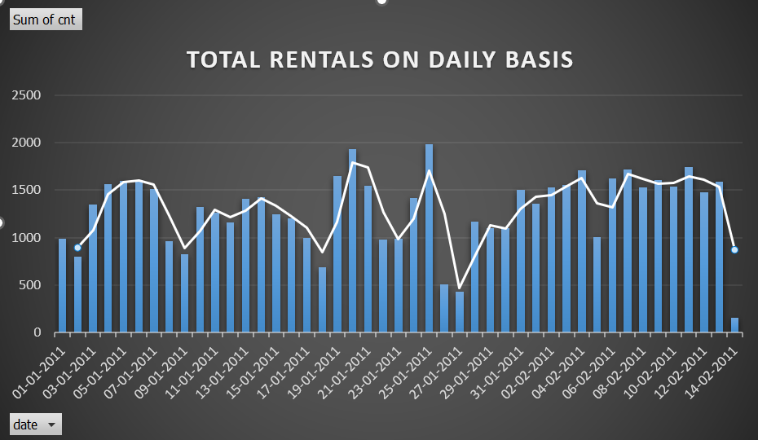
Daily rental volume
The data highlights fluctuations and trends in rental activity over the two months. Noticeable patterns include a progressive increase in rentals on certain dates, indicating the influence of weekends. The chart helps to understand the daily demand dynamics of rentals, identify peak usage days, and assess variability in rental volume

Slide 9
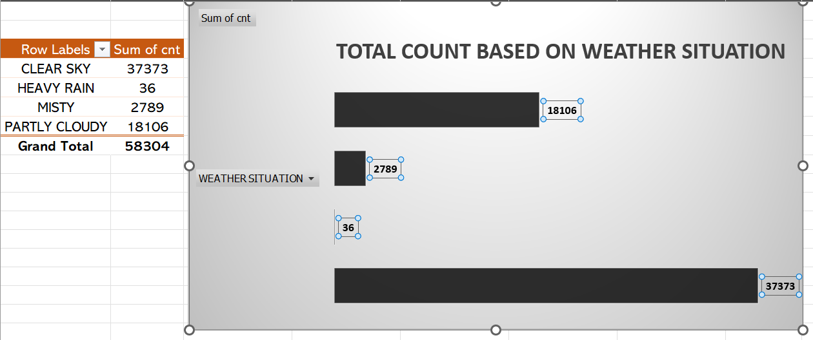
Weather impact: rentals by weather situations
The chart illustrates the number of rentals categorized by different weather situations. It reveals how weather conditions influence rental activity, highlighting trends such as a strong preference for clear skies, with substantially fewer rentals during heavy rain.

Slide 10
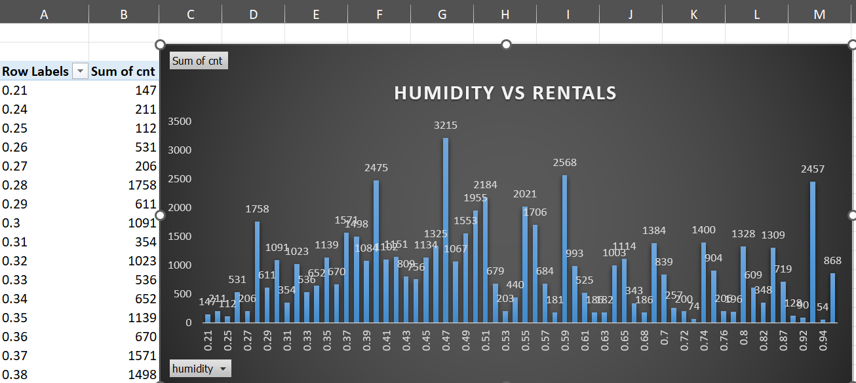
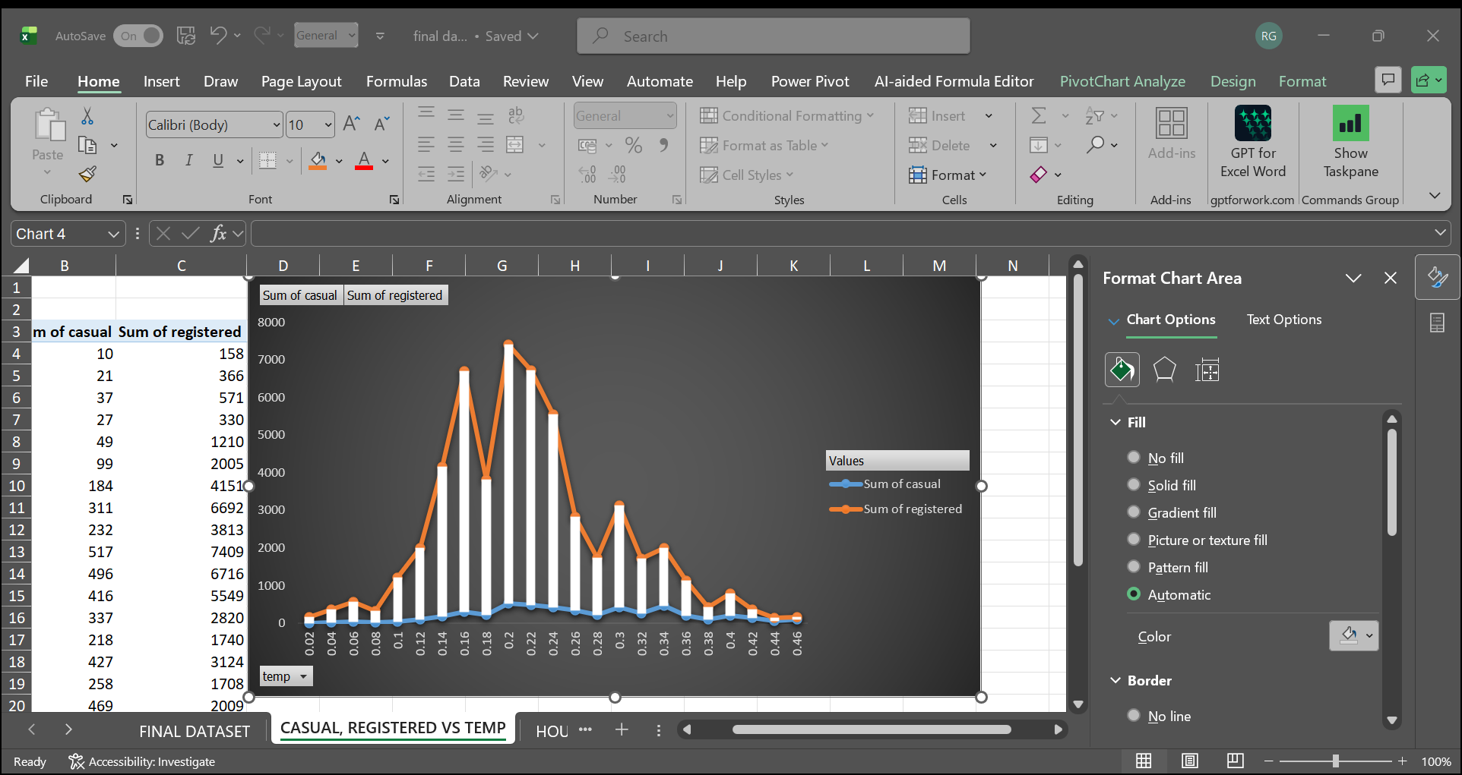
TEMPERATURE AND HUMIDITY EFFECTS
Data reveals a clear trend indicating that bike rentals decline as humidity levels increase.
This inverse relationship suggests that higher humidity likely discourages rentals due to discomfort or adverse weather conditions.
Observations also show that rental activity decreases when temperatures either rise or fall significantly.
Understanding these correlations is crucial for businesses to effectively anticipate and manage bike rental operations under varying weather conditions.

Slide 11
WINDSPEED AND HOLIDAY RELATION WITH RENTALS
WINDSPEED
HOLIDAY
The windspeed ranges between 0.16 and 0.22, showing that the highest bike rental activity, peaking at 0.20. This indicates that moderate winds may encourage more rentals, possibly due to favourable cycling conditions and increased comfort.
Rental shows notable peaks on holidays, surpassing weekdays and weekends. This indicates that holidays significantly influence rentals, interacting uniquely with regular weekly trends
Operational implications- These periods demand strategic operational adjustments to handle increased volumes.
Efficient redistribution of bikes is essential to meet elevated holiday demand and maintain service quality.

Slide 12
Key findings summary
Bike rentals reach their peak between 8 AM and 5 PM, aligning with commuter hours, where 77 hours are noted to have rental(cnt) above 150, and the total of these rentals came out to be 14,027.
Weekday and weekend rentals total 42,425 and 15,869, respectively.
Favourable weather conditions, such as clear skies and moderate temperatures around the normalized average of 0.2, significantly boost rental activity.
Elevated humidity levels exhibit a dampening effect on usage. Casual users show more sensitivity to temperature change, with a correlation coefficient of 0.47, compared to registered users, signalling that weather influences casual rentals more strongly.

Slide 13
ACTIONABLE RECOMMENDATIONS
OPTIMIZE AVAILABILITY
Prioritize bike availability from 8 AM to 5 PM on weekdays to align with the peak usage by registered users to display consistent demand throughout the timeline
This focus supports efficient bike distribution and maximizes utilization during high-demands
LEVERAGE INSIGHTS
Promote casual riding on warm, low-humidity days by leveraging targeted customer campaigns and dynamic pricing strategies.
By capitalizing on favourable weather conditions, the program can efficiently boost user engagement and overall rental volumes

Slide 14
THANK YOU

